Slide 1
Predictive analytics in Business
Scenarios - case studies.

Slide 2
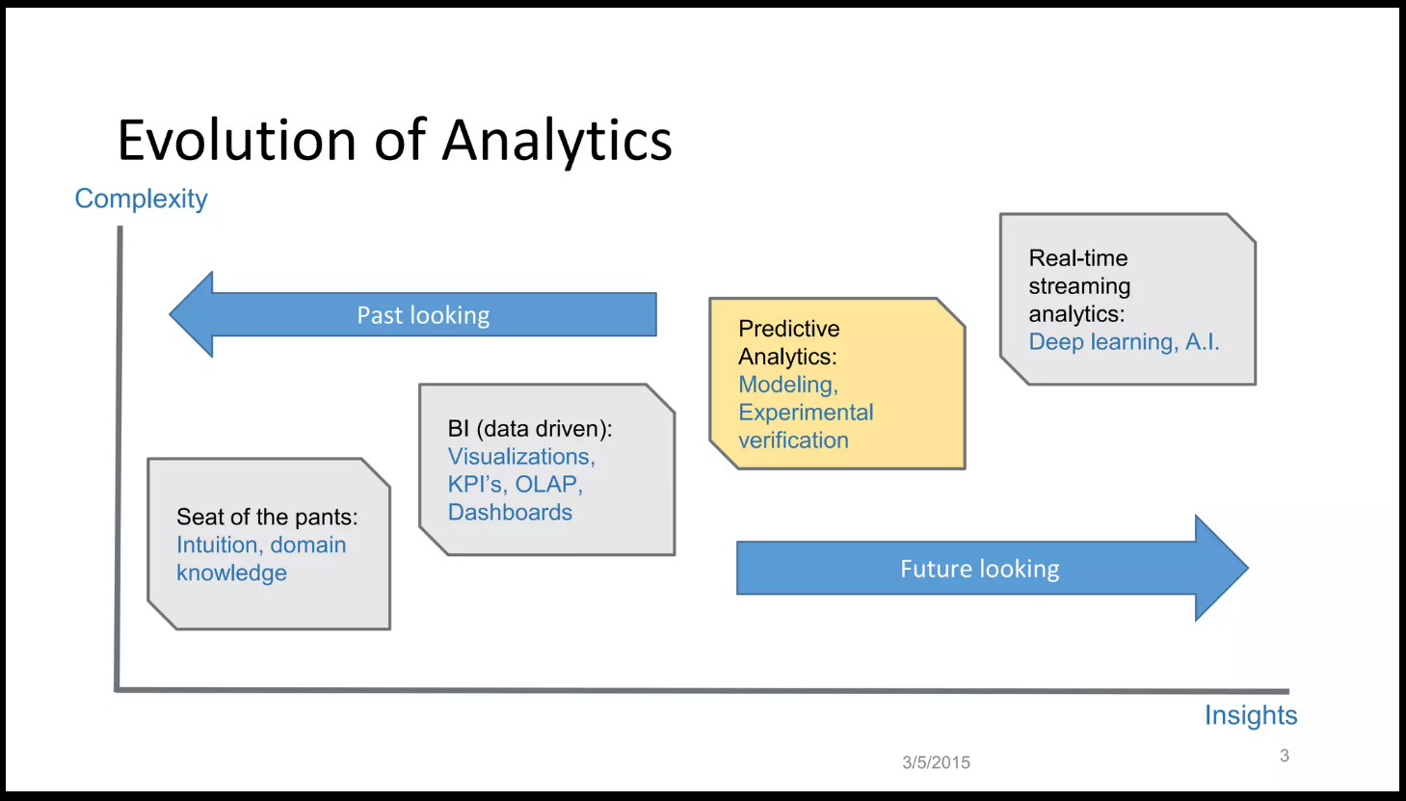

Slide 3
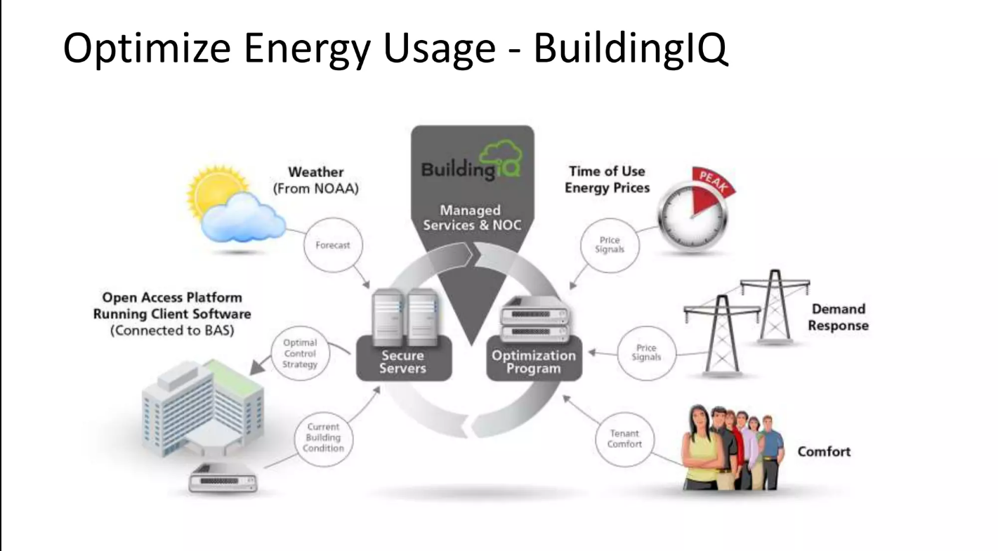

Slide 4
Today, businesses regularly use predictive analytics to target customers and achieve better operational results. There are countless examples of predictive analytics in marketing, manufacturing, real estate, software testing, healthcare, and many more.
Predictive analytics models are integrated within applications and systems to identify future results.

Slide 5
1.Predicting buying behavior
One of the biggest uses of predictive analytics is predicting buying behavior in the retail industry. Companies use the tools to learn all about their customers. Companies use advanced analytics to identify buying habits based on previous purchase history.
Walmart is a great example. It used early data to understand buying behavior in certain circumstances. Small ecommerce retailers can incorporate predictive analytics in PoS to predict customer purchase patterns. It helps to understand customers on a deeper, more personalized level.

Slide 6
2. Fraud detection
As cybersecurity becomes a growing concern, predictive analytics examples are plenty. The most important one is fraud detection. These models can identify anomalies in the system and detect unusual behavior to determine threats.
For example, experts can feed historical data of cyberattacks and threats to the system. When the predictive analytics algorithm identifies something similar, it will send a notification to the respective personnel. It will limit the entry of hackers and vulnerabilities that might put the system at risk.

Slide 7
3. Healthcare diagnosis
The healthcare industry is benefitting the most from the predictive analysis module. Health data is critical to understand the history and current illness of any patient. Predictive analytics models help in understanding the disease by providing an accurate diagnosis based on past data.
With the help of certain health factors, predictive analytics help doctors reach the root cause of diseases. It gives them timely analytics so that they can start working on the treatments at an early stage. With the help of predictive analytics models, the spread of negative health effects can be stopped.

Slide 8
4.Card abandonment
Retailers love this application of predictive analytics. Cart abandonment is a big issue. However, based on past history, models can predict how likely a customer is to abandon the cart.
For example, by feeding the data to the model of purchase made and cart abandoned, the model predicts how many customers will abandon it. It will also provide companies with details about each customer about whether they will purchase or abandon the cart based on the previous visits to the store.

Slide 9
5.Content recommendation
One of the most relatable and visible predictive analytics examples is content recommendation. Through algorithms and models, entertainment companies can predict what users want to watch based on their history.
When you ask, “what companies use predictive analytics?” The most relevant answer is Netflix. The entertainment company utilizes predictive algorithms to recommend content to users based on genre, keywords, ratings, and more. The intelligent system uses highly advanced analytics for predicting the user’s behavior.

Slide 10
6. Equipment maintenance
Predictive analytics models are significant for manufacturing, healthcare, and other businesses that require scheduled equipment maintenance. An accidental equipment breakdown can risk human lives and lead to major losses for the company as well.
For example, by integrating IoT with equipment, manufacturing units can feed data to understand when the equipment would require maintenance. In this way, the machinery would alert the personnel and the maintenance can be done to avoid unscheduled and accidental breakdowns.

Slide 11
7. Virtual assistants
Combined with the power of deep learning, predictive analytics works wonders when utilized with virtual assistants. Siri, Ok Google, and Alexa are real-world use cases of predictive analytics projects. These virtual assistants learn from the user’s behavior and then deliver accurate results.
Companies also use virtual assistants that act as chatbots. It improves the customer experience as these bots learn from interactions and predict what the customer’s response would be. They are self-learning and enable companies to better manage customers without hiring a lot of support staff.

Slide 12
In a nutshell
The predictive analytics marketing strategy is bringing a revolution in how companies use to operate. It is using historical data to predict trends and behavior that enable companies to build better products and provide excellent services.
We saw that limitless industries use predictive analytics, including finance, healthcare, retail, manufacturing, and many more. They reap significant benefits by identifying future values, customer behavior, and maintenance schedules to enhance their profitability.

Slide 13
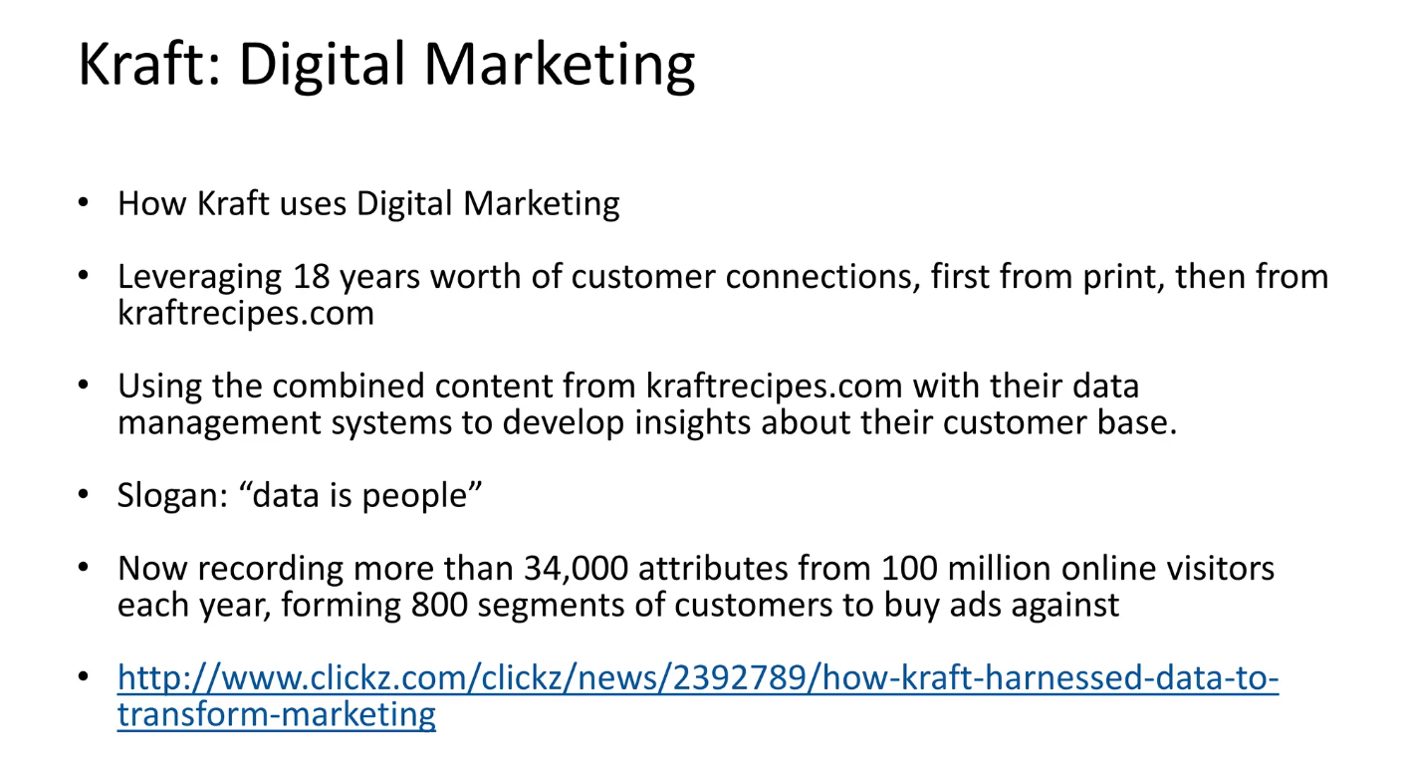

Slide 14
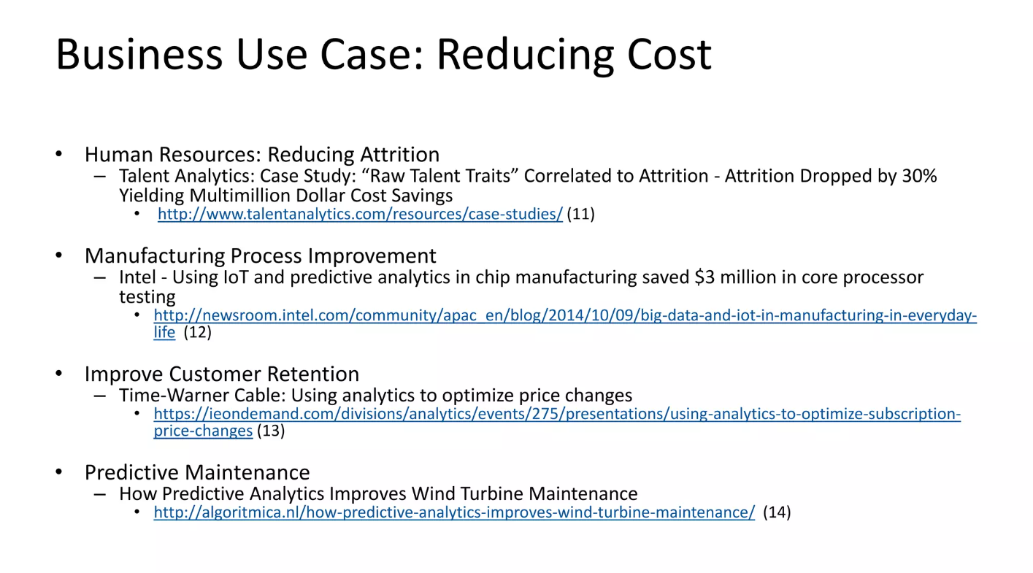

Slide 15
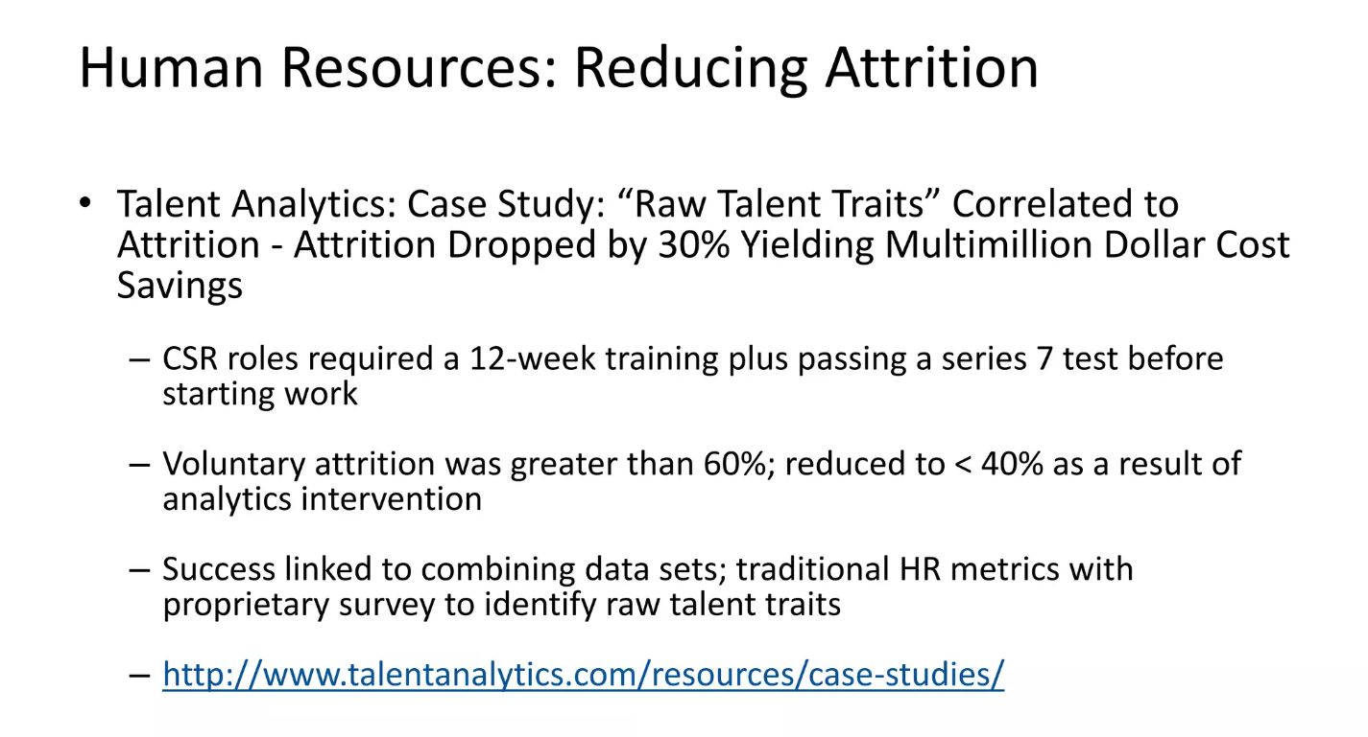

Slide 16
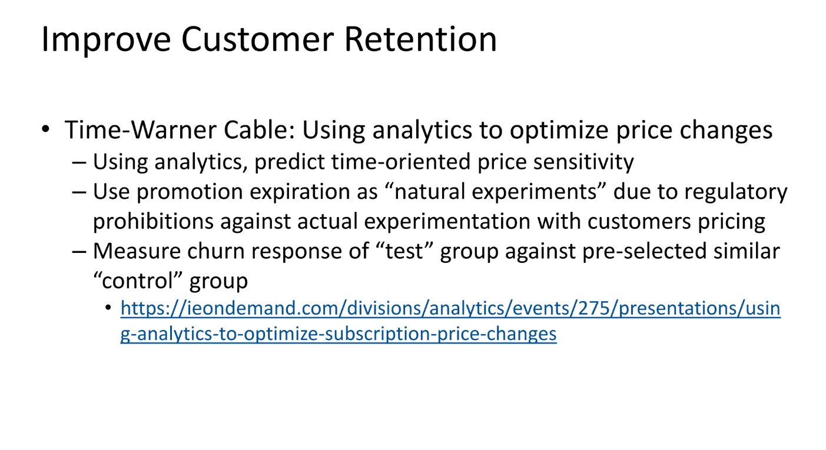

Slide 17
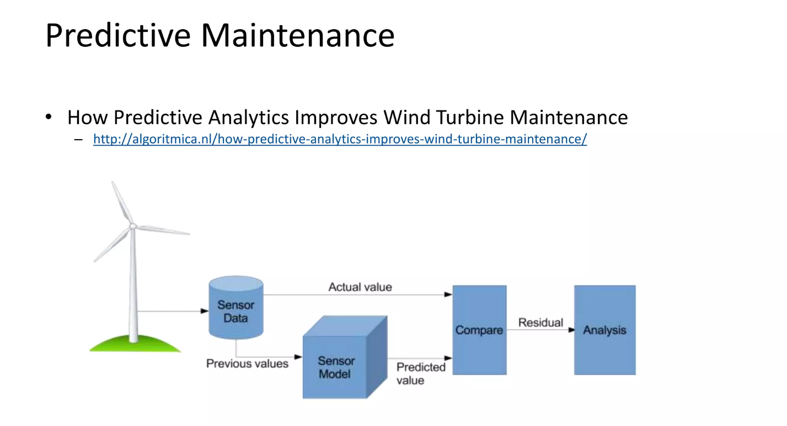

Slide 18
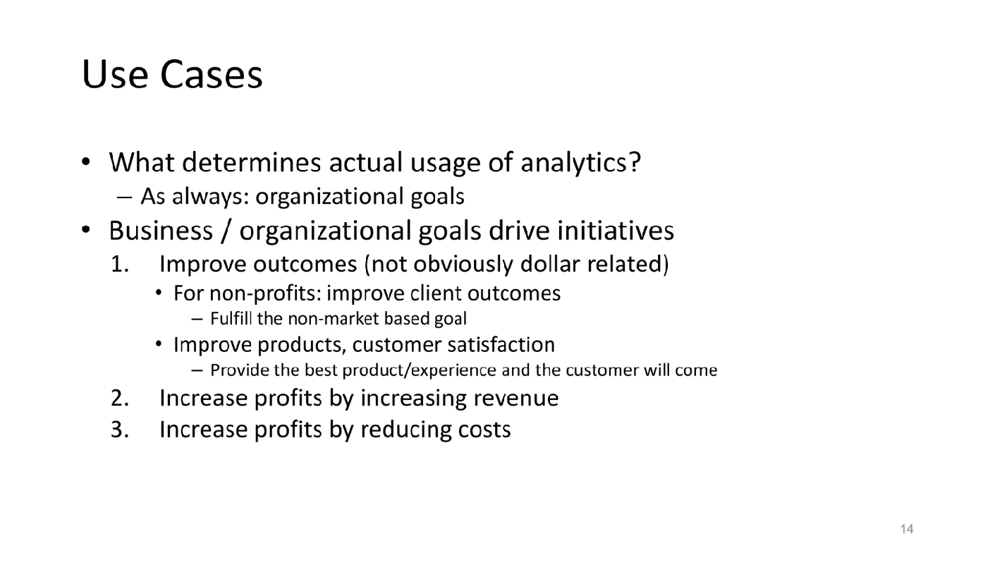

Slide 19
Case Studies
Target: Target, the retail giant, uses predictive analytics to identify pregnant customers and send them targeted promotions. By analyzing purchase histories and behavioral data, Target can predict when a customer is likely to be pregnant and offer them promotions on baby-related products.
Amazon: Amazon uses predictive analytics to recommend products to customers based on their purchase history, browsing behavior, and other factors. By analyzing this data, Amazon can suggest products that customers are likely to be interested in and increase the chances of a purchase.

Slide 20
Uber: Uber uses predictive analytics to estimate the demand for rides in different areas at different times. This helps drivers optimize their routes and helps Uber ensure that there are enough drivers available to meet the demand.
Netflix: Netflix uses predictive analytics to recommend movies and TV shows to its customers based on their viewing history and ratings. By analyzing this data, Netflix can suggest content that customers are likely to enjoy and keep them engaged with the platform.

Slide 21
American Express: American Express uses predictive analytics to identify customers who are at risk of leaving the company. By analyzing transaction histories and other data, American Express can identify patterns that indicate a customer may be dissatisfied and offer them incentives to stay.
These are just a few examples of how predictive analytics can be used to improve business outcomes. By using data to make predictions about customer behavior, demand, and other factors, companies can make better decisions, optimize their operations, and increase customer satisfaction.

Slide 22
Thank You

Slide 23
Surprise Test
Briefly Explain the Predictive analytics Process.
Briefly Explain the Application of predictive Analytics.
Explain with neat Diagram for Evolution of analytics
Why is predictive analytics important?

